Slide 1

GOODCAB SERVICES
Strategic Insights for Operational Excellence
Challenge #13: Provide Insights to Chief of Operations in Transportation Domain
By - Gaurav Wankhede
Deployed - https://goodcabs-tier-2-cities.onrender.com

Slide 2


Table of Contents
01
02
03
INTRODUCTION
Dashboard
Ad Hox Request Analysis

Slide 3
Table of Contents
01
02
Company Overview
Problem Statement

Slide 4
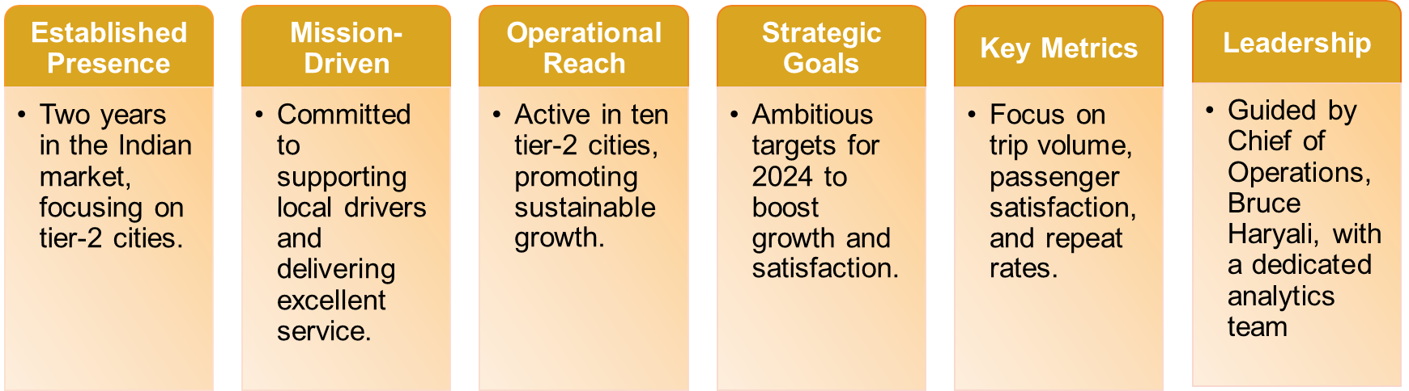
Company Overview

Slide 5
Problem Statement
Goodcabs operates in 10 tier-2 cities across India, focusing on supporting local drivers and delivering excellent service.
Aims to achieve ambitious 2024 targets by improving key metrics:
Trip volume
Passenger satisfaction
Repeat passenger rate
Trip distribution
The Chief of Operations requires immediate actionable insights to assess performance.
Task assigned to the data analyst as the analytics manager is engaged elsewhere.
Responsibilities include:
Analyzing datasets thoroughly
Designing a self-explanatory dashboard
Addressing key business questions
Delivering actionable insights via an engaging presentation.

Slide 6
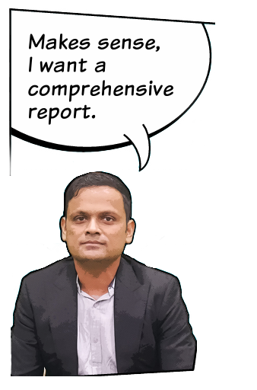

Dashboard

Slide 7
Dashboard
Deployed - https://goodcabs-tier-2-cities.onrender.com

Slide 8
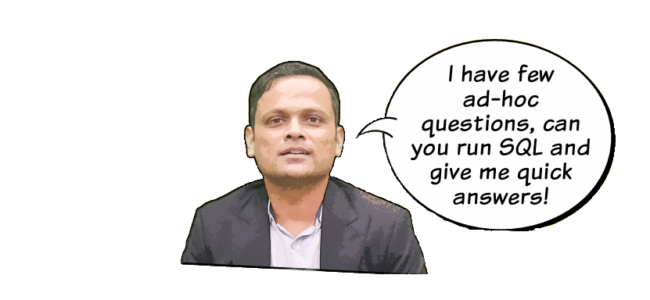
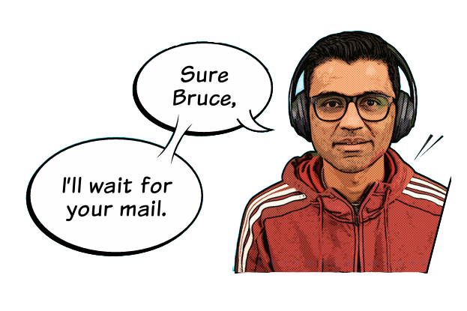
Ad Hoc Request Analysis

Slide 9
Business Request - 1:
City-Level Fare and Trip Summary Report
Generate a report that displays the total trips, average fare per km, average fare per trip, and the percentage contribution of each city's trips to the overall trips. This report will help in assessing trip volume, pricing efficiency, and each city's contribution to the overall trip count.

Slide 10
Business Request - 2:
Monthly City-Level Trips Target Performance Report
Generate a report that evaluates the target performance for trips at the monthly and city level. For each city and month, compare the actual total trips with the target trips and categorize the performance as follows:
If actual trips are greater than target trips, mark it as "Above Target".
If actual trips are less than or equal to target trips, mark it as "Below Target".
Additionally, calculate the % difference between actual and target trips to quantify the performance gap.

Slide 11
Business Request -3:
City-Level Repeat Passenger Trip Frequency Report
Generate a report that shows the percentage distribution of repeat passengers by then umber of trips they have taken in each city. Calculate the percentage of repeat passengers who took 2 trips, 3 trips, and so on, up to 10 trips.
Each column should represent a trip count category, displaying the percentage of repeat passengers who fall into that category out of the total repeat passengers for that city.
This report will help identify cities with high repeat trip frequency, which can indicate strongcustomer loyalty or frequent usage patterns.

Slide 12
Business Request - 4:
Identify Cities with Highest and Lowest Total New Passengers
Generate a report that calculates the total new passengers for each city and ranks them based on this value. Identify the top 3 cities with the highest number of new passengers as well as the bottom 3 cities with the lowest number of new passengers, categorizing them as "Top 3" or "Bottom 3" accordingly.

Slide 13
Business Request - 5:
Identify Month with Highest Revenue for Each City
Generate a report that identifies the month with the highest revenue for each city. For each city, display the month_name, the revenue amount for that month, and the percentage contribution of that month's revenue to the city's total revenue.

Slide 14
Business Request - 6:
Repeat Passenger Rate Analysis
Generate a report that calculates two metrics:
Monthly Repeat Passenger Rate: Calculate the repeat passenger rate for each cityand month by comparing the number of repeat passengers to the total passengers.
City-wide Repeat Passenger Rate: Calculate the overall repeat passenger rate foreach city, considering all passengers across months.
These metrics will provide insights into monthly repeat trends as well as the overall repeat behaviour for each city.

Slide 15
THANK YOU
Gratitude turns what we have into enough and more. Thank you for your time, trust, and support.
Do you have any Questions?
Click here
By - Gaurav Wankhede
Deployed - https://goodcabs-tier-2-cities.onrender.com

